Slide 1
(D)DoS in CCN: Evaluation & Countermeasures
September 12, 2012
Ongoing collaborative work between PARC, UCLA and UCI

Slide 2
What is DoS attack?
Goal: Prevent legitimate resource usage
i.e., attack on availability
Resources, e.g.,
Memory, CPU, Bandwidth, Storage etc.
Distributed DoS (DDoS) attacks are common on today’s Internet

Slide 3
(D)DoS in CCN: IP vs. CCN
CCN is fundamentally different than IP
Not push based
Data transmission must be preceded by a request for that data.
Most DoS attacks in IP are possible because unsolicited data can be sent anywhere
Reliable Forwarding Plane
Interest and data follow the same path (i.e., immediate feedback to routers)
Easy to secure routing (remains challenging in BGP)
Better resiliency with multi-path routing
Most current DoS attacks on IP are not applicable to CCN.
What about new DoS attacks, specific to CCN?

Slide 4
(D)DoS in CCN: Two Major Threats
Content Poisoning:
Adversary introduces junk or fraudulent content
Pollutes router caches and consumes bandwidth
Invalid signatures or valid signatures by invalid producers
Not easy to implement: cannot unilaterally push content
there will likely be trust mechanisms to register namespaces, etc.
Interest flooding:
Adversary injects a large number of spurious interests
Non-sensical distinct interests: not collapsible by routers
Consume PIT state in intervening routers as well as bandwidth
Legitimate CCN traffic suffers…
Easy to implement
Current CCNx has no countermeasures
This talk is focused on interest flooding

Slide 5
Interest Flooding Attacks
Why interest packets could be used for DoS?
Interests are unsolicited
Each non-collapsible interest consumes state (distinct PIT entry) in intervening routers
Interests requesting distinct data cannot be collapsed
Interests (usually) routed towards data producer(s)
Can such attacks be prevented?
Short Answer: Yes
Unlike IP routers, ccn routers maintain rich state information that can be used to detect and react to interest flooding

Slide 6
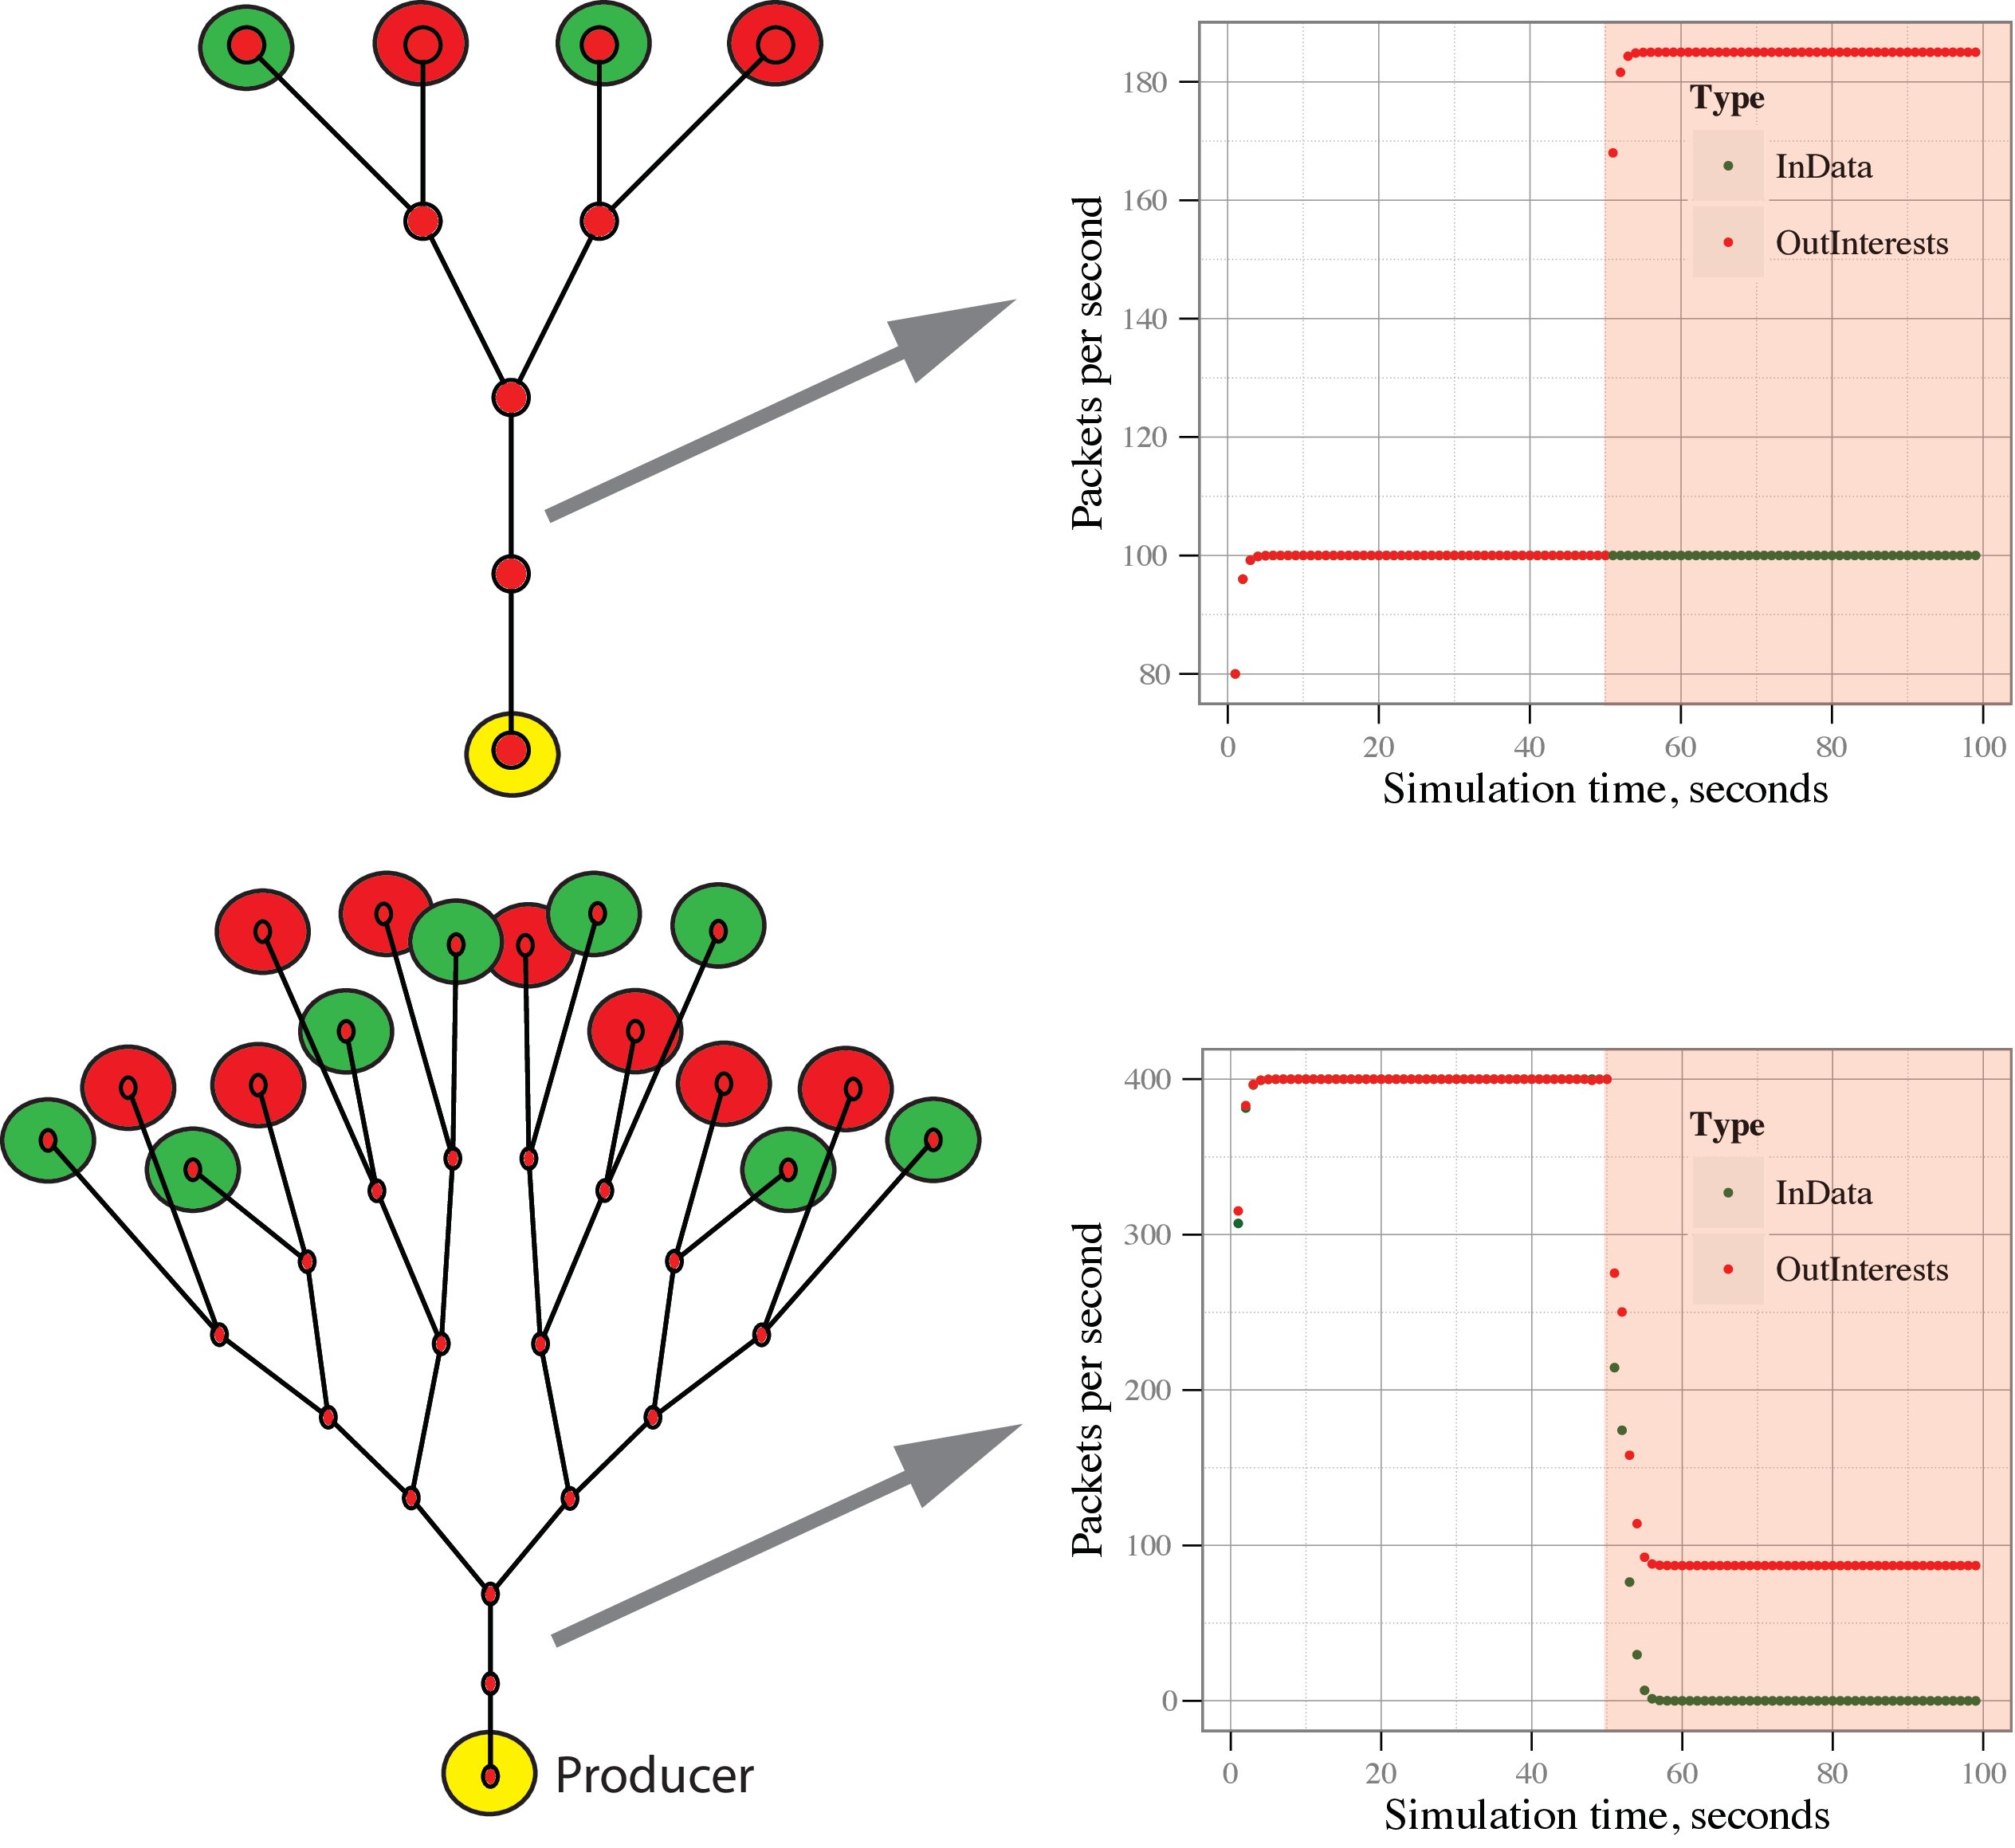
Picture of an (interest flooding) attack

Slide 7
Exploring the solution space
Simulation-based small experimentations
ndnSIM modular NDN simulator
http://ndnsim.net
different scale topologies
binary trees (3, 31, 128 nodes)
10Mbps links
propagation delays randomized from range 1-10ms
No caching (worst case scenario)
simple attacker model
Sends targeted interests (common prefix) for non-existing content
up to 50% attacker population
various mitigation techniques
Emulation-based verification
Large scale simulations for promising mitigation techniques

Slide 8
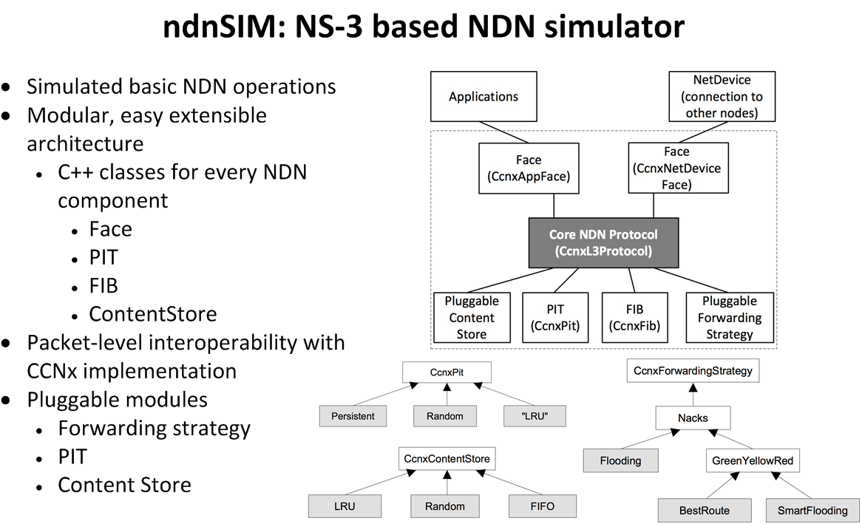
Brief intro to ndnSIM

Slide 9
Respecting physical (bandwidth) limits
Current CCNx code does not limit the PIT size, or the # of Pending interests for any interface
Downstream can send more interests than physically possible to satisfy.
CCN has balanced flow between Interests & Data
Number of Interests defines upper limit on Data packets
The number of pending Interests to fully utilize a link with data packets is:

Slide 10
That limit alone is not sufficient
In small topologies, prevents attackers from injecting excessive # of interests.
As expected, it does not work in big topologies
No differentiation between good and bad traffic.

Slide 11
Utilizing the state information in routers
Theoretically, CCN routers have all the information needed to be able to differentiate good interests from bad ones.
To be effective in DoS, bad interests need to be insuppressible and requesting non-existing content.
On the other hand, good interests will likely be satisfied with a content
Keep per incoming interface, per prefix (FIB entry) interest satisfaction statistics in routers
Use the statistics to detect and control bad traffic.
Notes:
Exponential moving average statistics.

Slide 12
Weighted round-robin on interest queues
when an Interest arrives
If (per-prefix/per-face) pending Interest limit is not reached
accept Interest and create PIT entry
If limit is reached
“buffer” Interest in per-outgoing face/prefix queue (within per-incoming face sub-queue)
set weight for per-incoming face sub-queue proportional to observed interest satisfaction ratio
when new PIT slot becomes available
accept and create PIT entry for an Interest from queues based on weighted round robin sampling

Slide 13
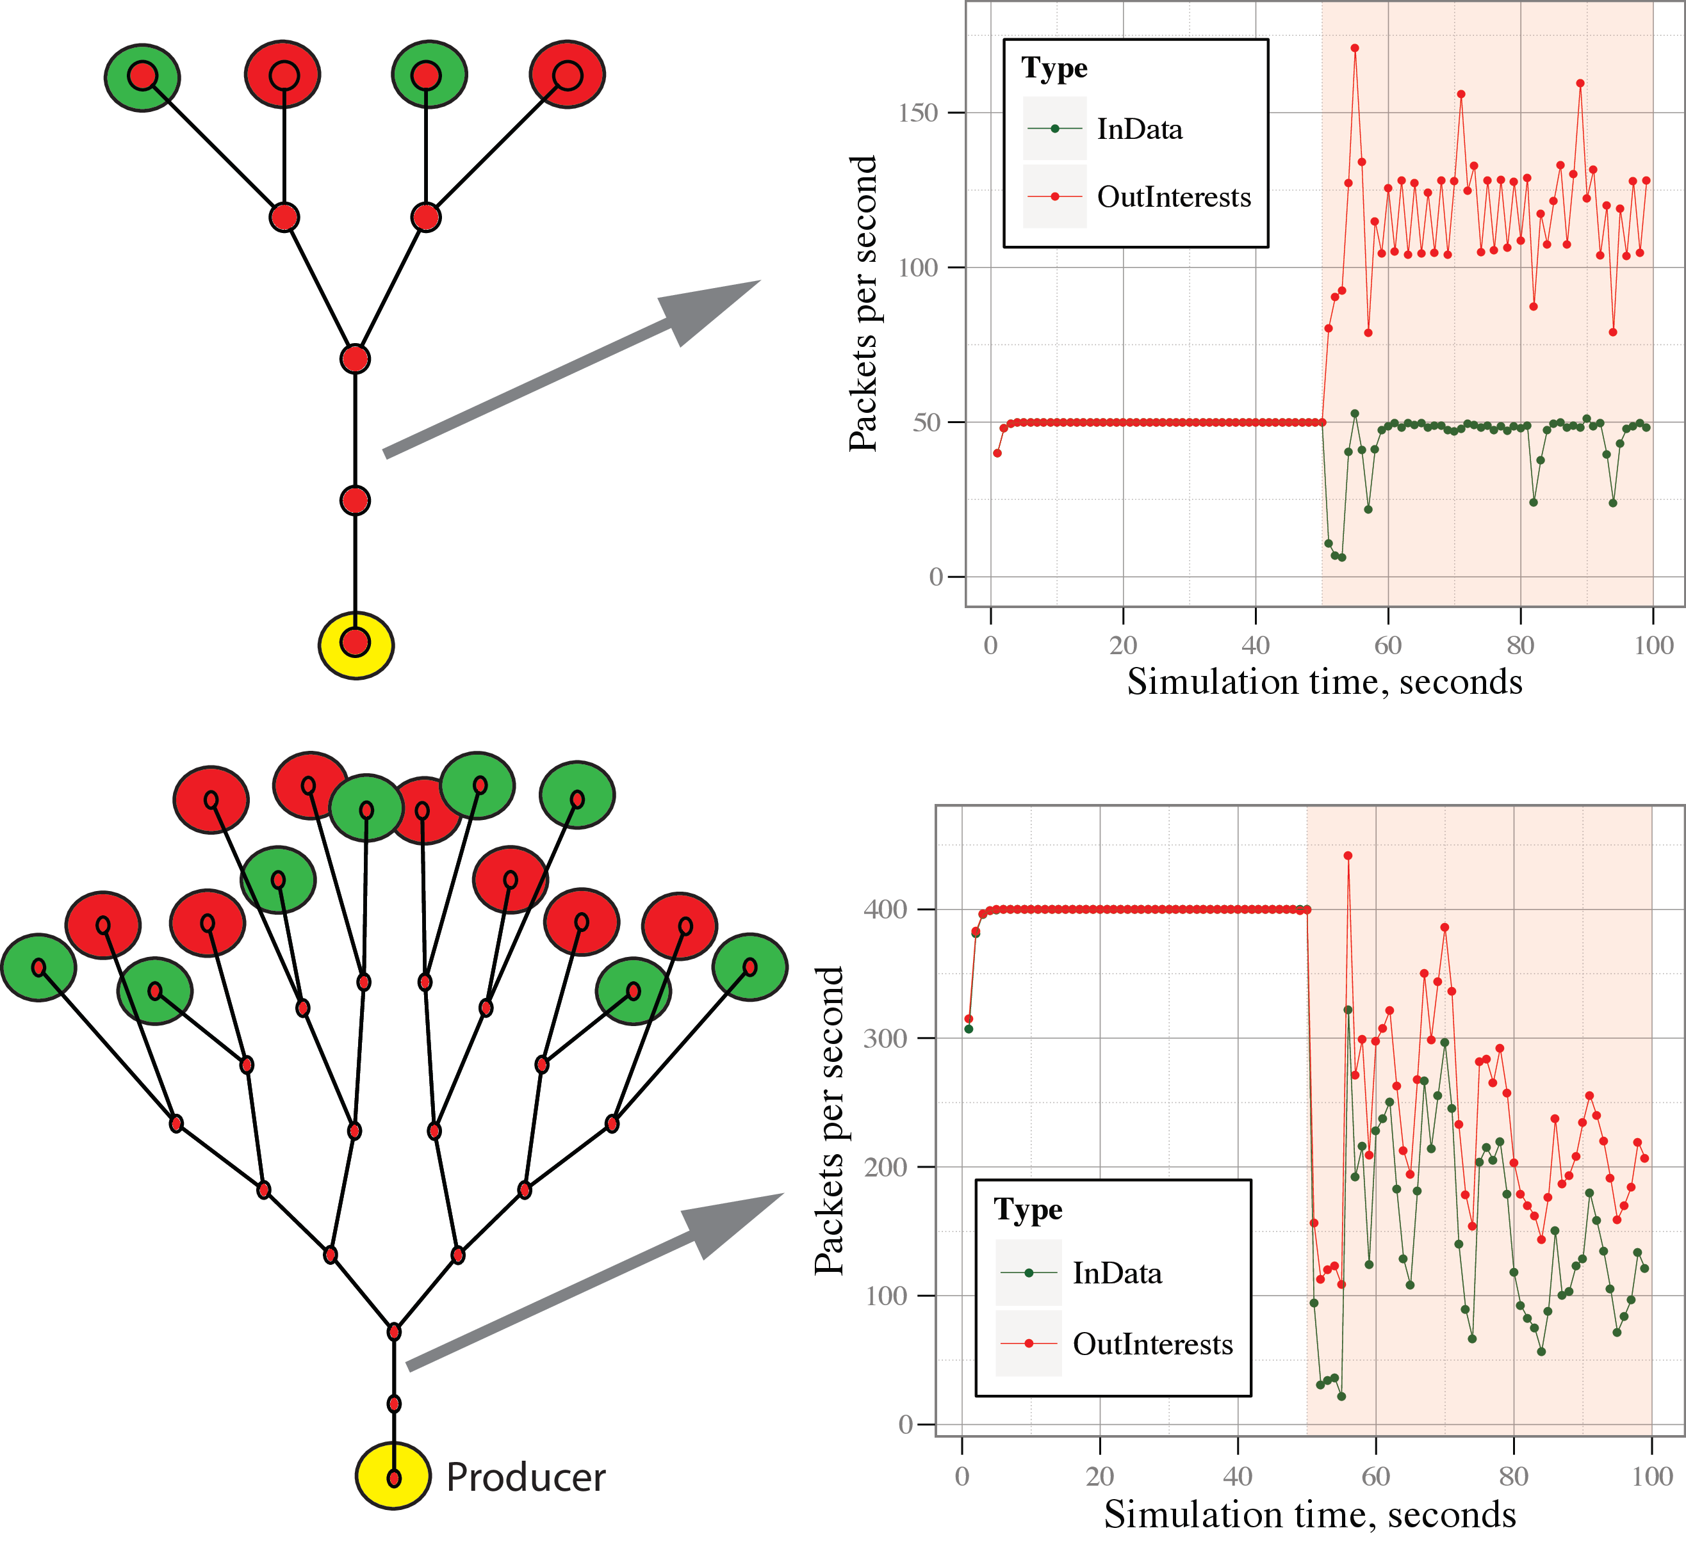

Weighted round-robin results
Partially works
more fair share of resources
Not effective at differentiating bad and good traffic (no-cache scenario)
Setting queue sizes and lifetime can get tricky
Will most likely improve if supplemented with NACKS (under testing)
Notes:
Queue lifetime 100ms, interest lifetime 1 sec.

Slide 14
Probabilistic Interest acceptance/drops
When an Interest arrives
“accept” if the outgoing face is utilized under a threshold
Otherwise, accept with probability proportional to the satisfaction ratio for Interests on this face and per-prefix
Even if satisfaction ratio is 0: “accept” with a low (“probe”) probability
All “accepted” Interests are still subject to (per-prefix/per-face) pending Interest limit
Notes:
Threshold 25% of window size

Slide 15
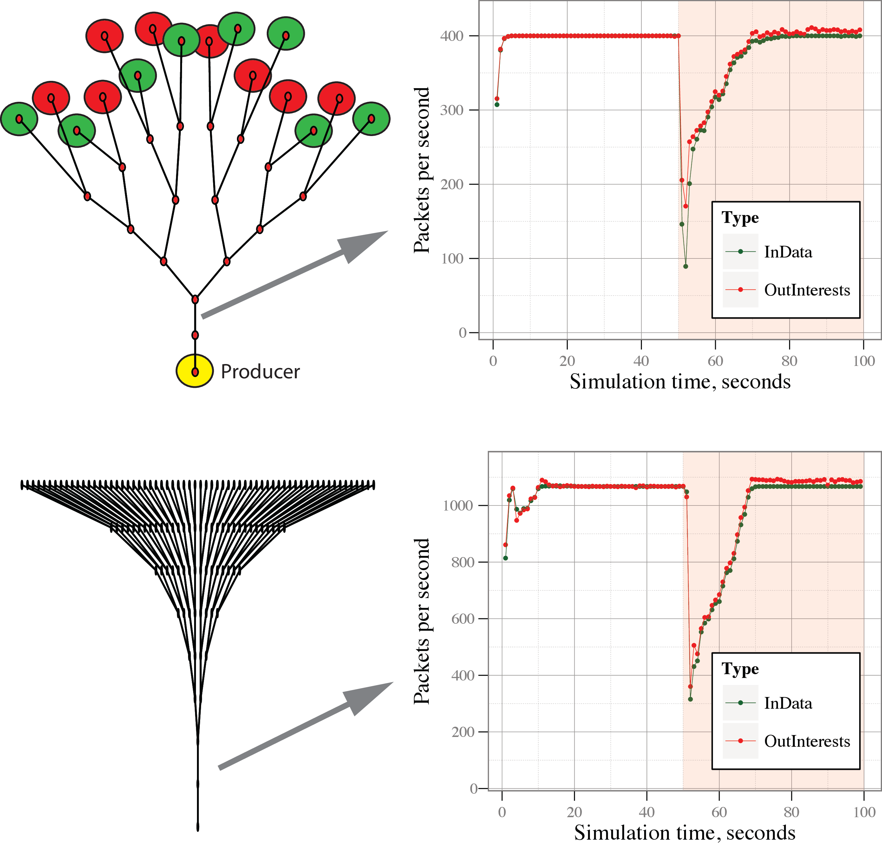

Probabilistic Interest acceptance Results
Parameter selection is important but may not be easy due to topology variances.
May result in link under-utilization
Works in general,
Might perform better with NACKs (more accurate statistics)

Slide 16
Dynamic Interest limit adjustments
Incorporate “active” PIT management
Periodically
for every FIB prefix
for all faces
Announce NoPI limit proportional to the satisfaction ratio
Min limit is 1 and sum of all announced limits is at least equal to sum of output limits
Notes:
In simulations, period is set to 1 sec.

Slide 17
Illustration of Dynamic limits
Just before the attack
Immediately after attack starts
Stabilized after the attack
Satisfaction rates
Satisfaction rates
Satisfaction rates
NA
1.0
1.0
0.0
1.0
0.0
1.0
1.0
NA
0.0
1.0
0.0
1.0
1.0
0.5
0.5
0.9
0.9
1.0
1.0
1.0
1.0
1.0
1.0
Announced limits
Announced limits
Announced limits
50
50
50
25
25
25
1
25
50
25
25
1
50
50
25
25
45
45
50
50
50
50
50
50

Slide 18
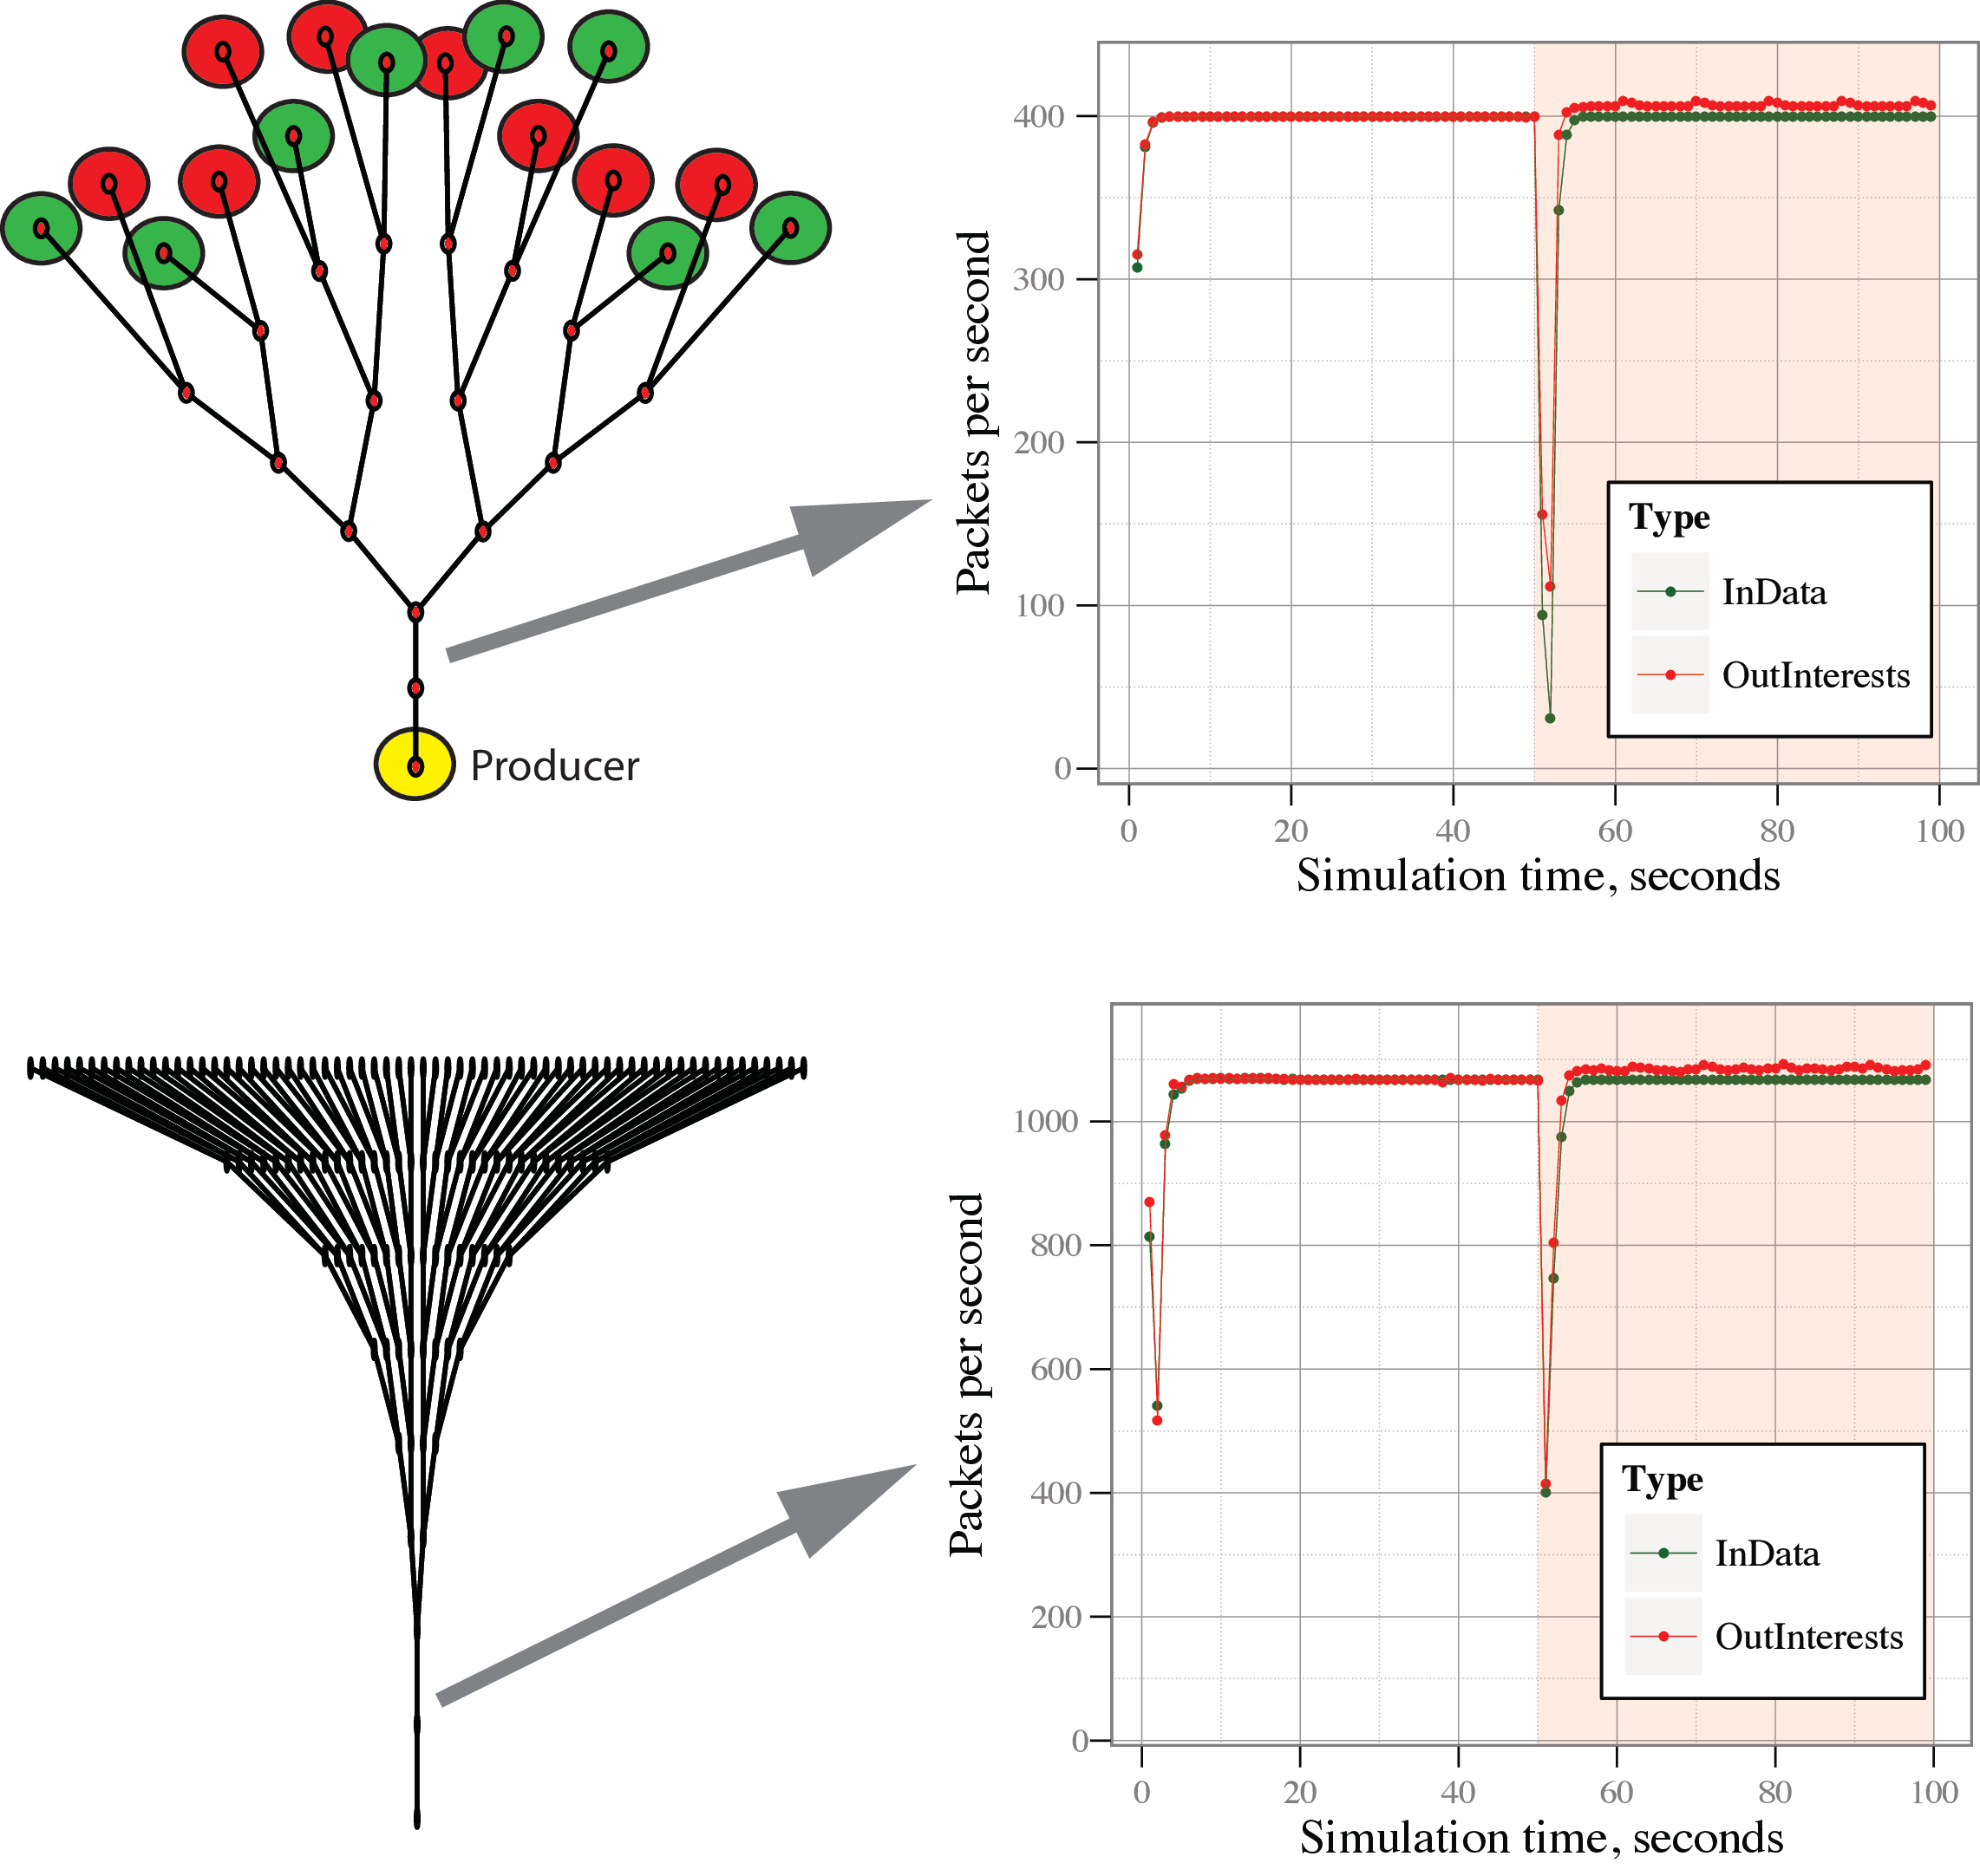
Dynamic limits results
Does not require much parameter tweaking
Works with all topologies tested

Slide 19
Large scale experimental setup
Rocketfuel Sprint topology
7337 routers and 10 000 links
Only adjacency = no link characteristics info
Extract
535 backbone routers
3339 gateway routers
3463 customer routers
Backbone <-> Backbone links are 100Mb with 70ms delay
Backbone <-> Gateways links are 10Mb with 20ms delay
Gateway <-> Customer links are 1Mb with 20ms delay

Slide 20
Large scale results

Slide 21
Thanks!
Questions?

Slide 22
BACKUP SLIDES

Slide 23
Overall evaluation results
Four-level tree
Different number of attacker nodes
1-8 attackers (6%-50%)
Different DDoS mitigation algorithms
dynamic Interest limit adjustments
probabilistic Interest accept
Queues with weighted round robin
PIT limits respecting physical link bandwidth (bandwidth-delay product)
no limits

Slide 24
Interest satisfaction ratios
10-run averages

Slide 25
Reaction to the attack (satisfaction vs. time)
4 (25%) attackers
Notes:
95% confidence intervals

Slide 26
Emulation vs. Simulation
Simulation is the primary evaluation tool in this project
NDN simulator vs CCNx ?
In Deterlab emulate CCNx in DDoS scenario on a small tree topology
Simulate the same in NDN simulator
Notes:
In emulation we have a real operating system Linux Ubuntu 10 with CCNx 0.6.0 installed
In emulation we have Java applications that use a normal java CCNx API and have the same functionality as applications in ndnSIM (Producer app, consumer app, malicious app)
Setup is as on the picture with 100Kb links, 40ms delay
Evil apps send packets every 2ms in emulation and every 2.8ms in simulation
Consumers send interests every 200ms
Producer is installed on the root node
All clients are on the leaves

Slide 27
Results of comparison
Shows the strength of DDoS attack (adjusted)
Malicious app sends Interests every 2.8 ms in simulation & 2ms in emulation (Operating System scheduling effect)
Shows successful data retrieval by legitimate consumers
DDos attack on [60,90] seconds
Notes:
Overall Simulation and Emulation provide a similar results after making a reasonable adjustments.
ndnSIM performs worse due to its deterministic nature, while the effects of UDP protocol usage, operating system scheduling, and kernel level operations on packet queues provide more randomness and a better intermixing of bad and good traffic that give a better perofrmance.

Slide 28
Large scale experimental setup
Realistic Internet scale topology
Rocketfuel Sprint topology (and others in future e.g. ATT)
Sprint is 7337 routers and 10 000 links
Only adjacency = no link characteristics info
Extract
535 backbone routers
3339 gateway routers
3463 customer routers
Backbone <-> Backbone links are 100Mb with 70ms delay
Backbone <-> Gateways links are 10Mb with 20ms delay
Gateway <-> Customer links are 1Mb with 20ms delay

Slide 29
Large scale experimental setup
Randomly choose 1 backbone router and install Producer app
Randomly choose 1%, 5%, 10%, 25% and 50% of customer routers that will have a malicious app installed on them
All other customer routers have a legitimate app installed

Slide 30
Large scale results

Slide 31
Large scale results

Slide 32
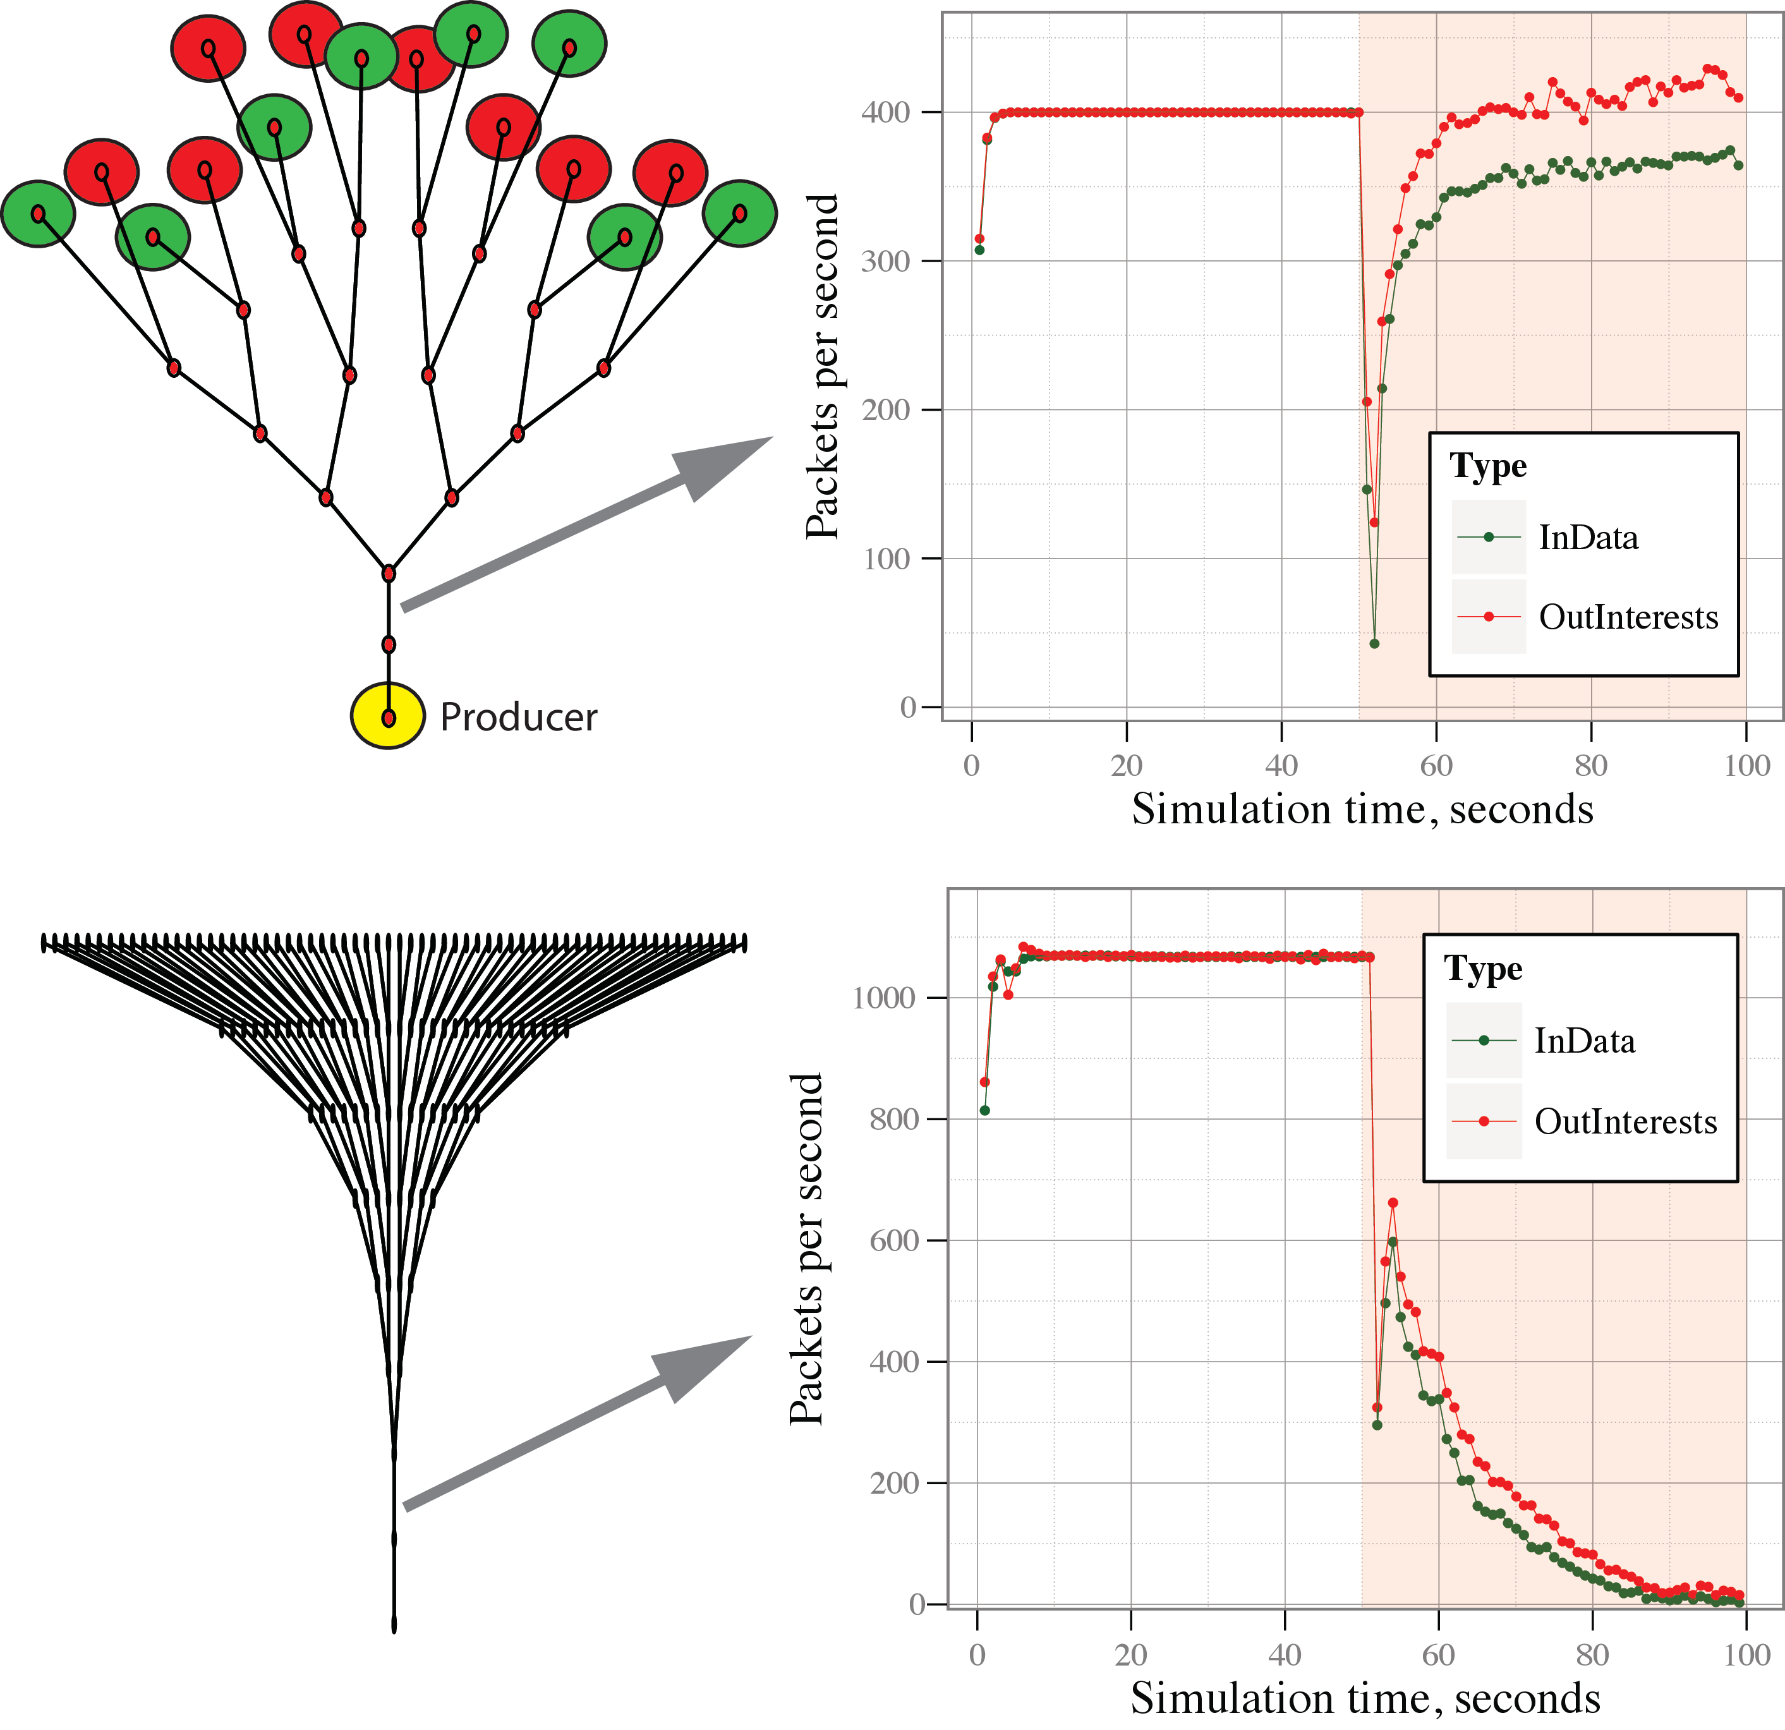

Probabilistic model. Effect of bad params
Performance may suffer significantly if parameters of the probabilistic model are adjusted incorrectly
“grace” acceptance increased from 1% to 5% compared to previous slide

Slide 33
Results on UCI’s pushback mechanism (poseidon)

Slide 34
PUSH-BACK OVER COMPLEX TOPOLOGIES
Deutsches ForschungsNetz

Slide 35
PUSH-BACK

Slide 36
PUSH-BACK
Baseline content traffic (no attack)
Content traffic under attack
With push-back-based countermeasure

